Slide 1

Feeling Good Ravencoin

Slide 2

Presenter - Tron Black
Crypto Developer
A Principal Developer
Medici Ventures
Ravencoin Lead Developer

Slide 3
What is Ravencoin?
A crypto-currency based on a fork of bitcoin that will be a platform for anyone to create their own asset.

Slide 4

The Ravencoin Phase 1 Team
Tron Black
Denny Becker
Tyler Perkins
Jonathan Dolan
Tai Chrysostom

Slide 5
The Current Ravencoin Dev Team
Tron Black
Jesse Empey
Corbin Fox
Mark Ney
Jeremy Anderson
Cade Call
Daben Steele
There are lots more people involved, at Overstock, and
worldwide, as this is a community project.

Slide 6
Raven Highlights
Oct 11, 2017 - First Public Announcement at MIT
Oct 25, 2017 - Announcement at Texas Bitcoin Conference
Oct 31, 2017 - Medium Post
Dec 21, 2017 - Mentioned at the Free State Blockchain Conference
Jan 3, 2018 - Genesis block created and Ravencoin launched
Code released
No pre-mine
Twitter announcements (@BruceFenton and @Ravencoin)
Mining begins

Slide 7


21 million coins
10 minute blocks
SHA256 Mining
50 BTC Reward
21 billion coins
1 minute blocks
X16r Mining
5000 RVN Reward

Slide 8
After Launch Raven Highlights
Jan 9 - Community run Telegram and Discord channels go live.
Jan 14 - Community member creates ANN on Bitcointalk
Jan 16 - First RVN mining pool
Jan 25 - Whitepaper for X16r released
CoinTelegraph Article
Jan 28 - First "Ravencoin Song"
Feb 16 - First Ravencoin Meetup in NH
Mar 4 - RVN added to exchanges
Mar 7 - Second Ravencoin song "Fly Like A Raven"
Apr 3 - Roadmap released
Apr 8 - Third song "Feeling Good with Ravencoin"

Slide 9
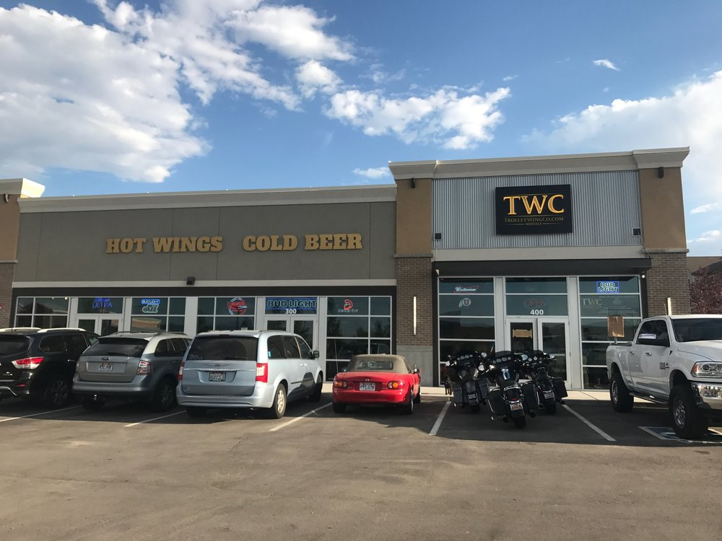
X16r - Where did it come from?

Slide 10
What is mining?
Block Header
<version>
<previous block hash> 0000000000000000007e8a29f052ac2870045ae3970270f97da00919b8e86287
<merkle root of tx>
Timestamp
Difficulty
Nonce
0
1
5832439
3
2
Winner
Hash
0
2²⁵⁶
~10⁷⁷

Slide 11
SHA256x2 - Bitcoin
X11 - Dash - 2014 - Evan Duffield
0=blake
1=bmw
2=groestl
3=jh
4=keccak
5=skein
6=luffa
7=cubehash
8=shavite
9=simd
A=echo

Slide 12
X11 - Dash
X13 - DeepOnion
X15 - HtmlCoin
X17 - Verge

Slide 13
x16r
0=blake
1=bmw
2=groestl
3=jh
4=keccak
5=skein
6=luffa
7=cubehash
8=shavite
9=simd
A=echo
B=hamsi
C=fugue
D=shabal
E=whirlpool
F=sha512

Slide 14
x16r - Rotates on bytes of previous block hash
0=blake
1=bmw
2=groestl
3=jh
4=keccak
5=skein
6=luffa
7=cubehash
8=shavite
9=simd
A=echo
B=hamsi
C=fugue
D=shabal
E=whirlpool
F=sha512
Previous Block Hash:
0000000000000000007e8a29f052ac2870045ae3970270f97da00919b8e86287
Previous Block Hash:
0000000000000000007e8a29f052ac2870045ae3970270f97da00919b8e86287

Slide 15
Ravencoin Community (the best)
Ravencoin.org
Ravencoin Discord
Ravencoin Telegram
RavencoinTalk.org
Announcement on Reddit
Raven.wiki
Ravencoin Twitter

Slide 16
Stats
https://rvnstats.info (Mark Henrie)
~1.9 TH/s Mining on network
~1,006,000,000 RVN issued through mining
~20,000 Difficulty

Slide 17
Songs by RavenCoinGirl
Ravencoin Song
Fly Like a Raven (Coin)
Feeling Good Ravencoin

Slide 18
What's Next?

Slide 19
Phase 2 - Assets
For 500 RVN, create your own token
Token name - Must be unique
Number of tokens - From 1 to 92 billion
How divisible? - From not divisible to 8 decimal places (0.00000001)
Reissuable?
LEMONADESTAND

Slide 20
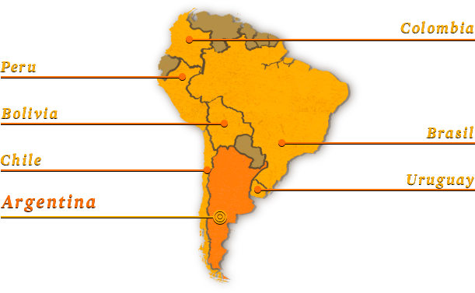
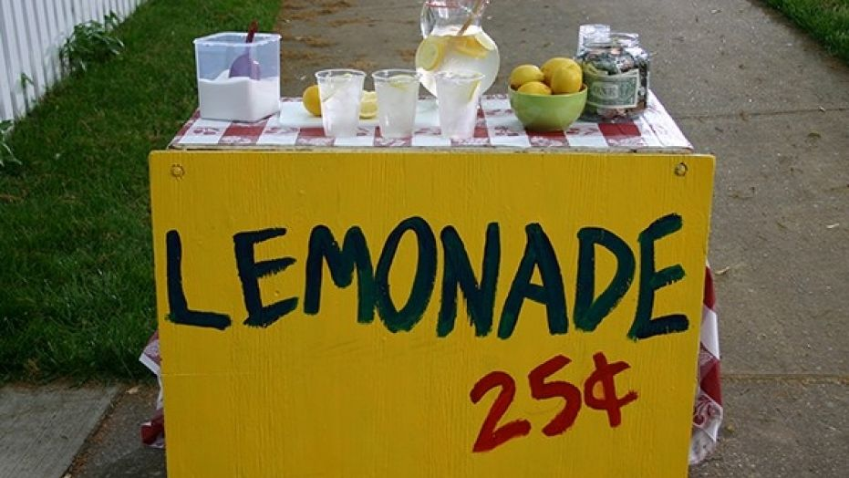
Use case for Ravencoin

Slide 21
Phase 2b - Sub-assets
For 100 RVN, create a sub-token
Token name - Must be unique when combined with token
Number of tokens - From 1 to 92 billion
How divisible? - From not divisible to 8 decimal places (0.00000001)
Reissuable?
LEMONADESTAND/GIFTOFLEMONADE

Slide 22
Phase 3 - Dividends (Rewards)
Pay your token holders in RVN*
Turn your profits into RVN and send out to all holders of your token by percentage held.
* Where permitted by law

Slide 23
Phase 4 - Unique Assets
Create one-of-a-kind assets.
ART#VenusDeMilo
CAR#<VIN number>
COOLGAME#SwordOfThor
Uses are limited only by the imagination

Slide 24
Phase 5 - Messaging
Broadcast a message to all of your token holders.
Send information about your token.
Send alerts relevant to your project.
Send information about a shareholder vote.
Use Raven messaging for other systems.
LEMONADESTAND

Slide 25
Phase 6 - Voting
Issue a special vote token to every holder of your token.
Send to <address X> to vote for X proposal
Send to <address Y> to vote for Y proposal
Second tier web voting can be built on top of this protocol.
LEMONADESTAND^VOTE

Slide 26
Phase 7 - Compatible Mode
Allows newly created assets to appear exactly like RVN, LTC, or Bitcoin for easy integration into exchanges, wallets, explorers, etc.
Speeds adoption into the larger crypto ecosystem.

Slide 27
How to buy Ravencoin?
CryptoBridge - https://crypto-bridge.org/
Nanex - https://nanex.co

Slide 28
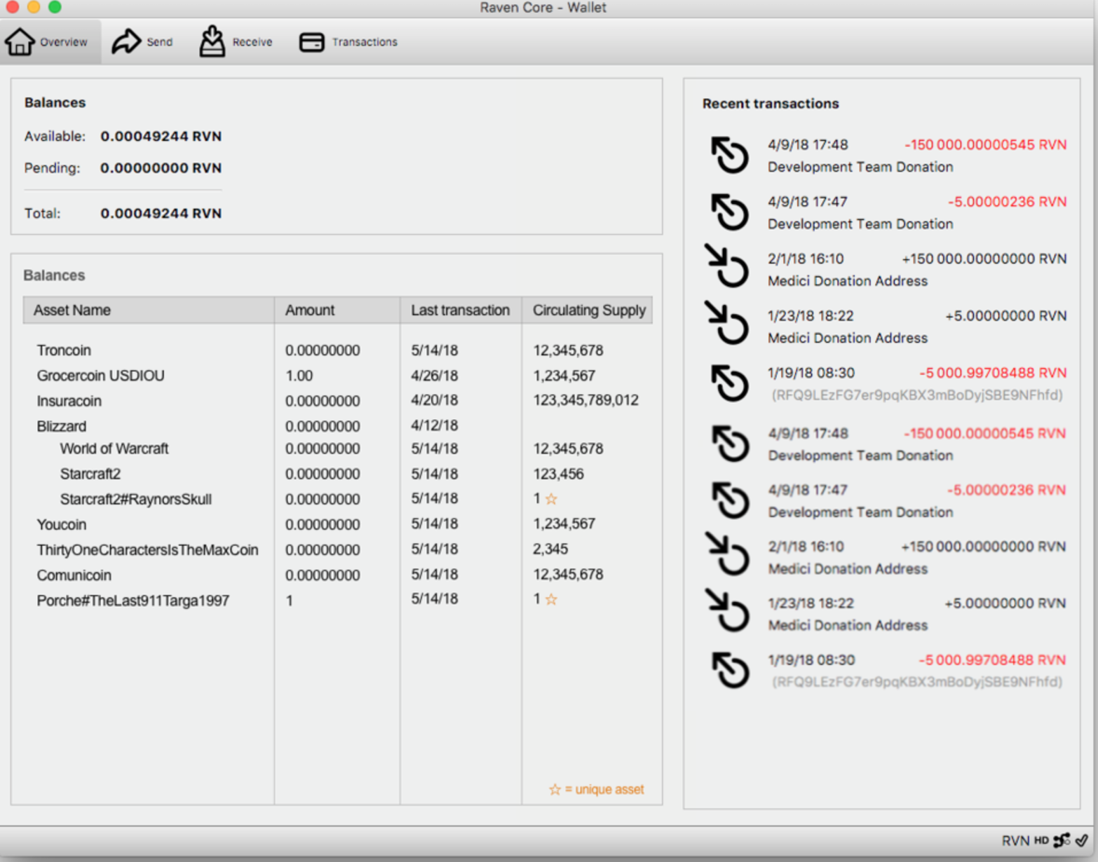

Slide 29
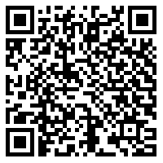
Q&A
Scan for a link to the presentation

